Slide 1
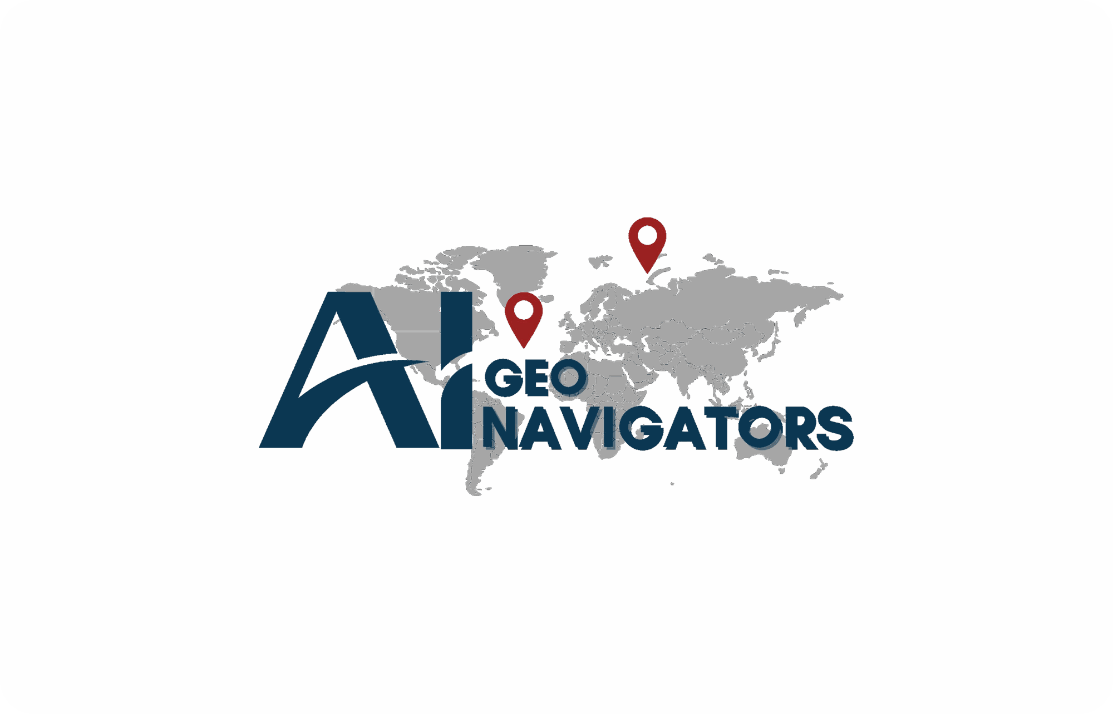
AT A GLANCE
30+
Climate, GIS & AI professionals
COMPANY PORTFOLIO · 2026
15+
Projects delivered and ongoing
Climate Intelligence.
Confident Decisions.
6
Proprietary AI engines
8
Scientific advisory board members
A climate-intelligence and geospatial firm turning environmental data into decisions — through structure, evidence, and signals that guide action.
4
Offices: Islamabad · Gilgit · Lahore · Delaware
2024
Incorporated SECP PK · 2025 Delaware LLC
GEOSPATIAL
AI
CLIMATE
ESG
aigeo360.com · info@aigeo360.com

Slide 2
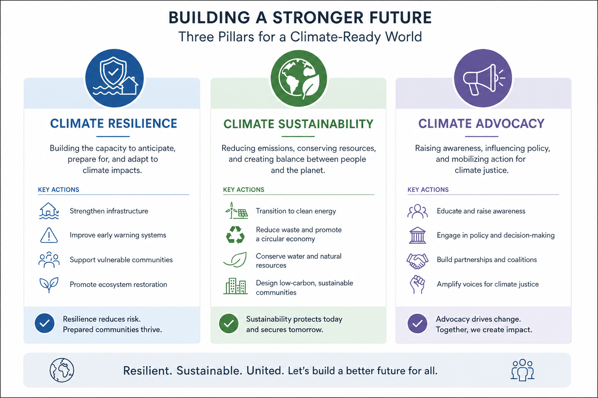
01 ABOUT US
2 / 22
Climate intelligence, built on geospatial AI.
AI Geo Navigators · Climate Intelligence. Confident Decisions.
www.aigeo360.com

Slide 3
02 MISSION & VISION
3 / 22
What we work towards.
MISSION
To deliver cutting-edge geospatial and digital solutions for data-driven decision-making, enhanced climate resilience, and sustainable development — through AI-driven innovation, collaboration, and capacity building across sectors and communities.
VISION
To be the leading force in geospatial innovation — empowering communities and organisations through intelligent mapping, sustainable data solutions, and digital transformation toward a resilient and informed world.
AI Geo Navigators · Climate Intelligence. Confident Decisions.
www.aigeo360.com

Slide 4
03 THE CASE
4 / 22
Resilience and early action work.
Why proactive climate intelligence is economic protection, not expense.
30%
4–10×
8×
$400B
Disaster losses avoided with 1 hour of early warning
ROI on resilience — every $1 invested saves $4–$10
Lower disaster mortality in countries with strong EWS
Annual global climate losses — and rising
UNDRR
WORLD BANK / UN
WMO
WMO / SWISS RE
THE FINANCIAL CASE
10–18%
GDP at risk by 2050 without adaptation
20–30%
Lifecycle cost reduction with risk-aware design
15–20%
Yield stability gain from drought monitoring
AI Geo Navigators · Climate Intelligence. Confident Decisions.
www.aigeo360.com

Slide 5
04 OUR ROLE
5 / 22
From risk awareness to risk reduction.
Operational intelligence at every stage of the climate-risk cycle.
WHAT WE DELIVER
THE RESILIENCE LOOP
Real-time hazard intelligence
1
OBSERVE
Live monitoring across multi-source feeds.
Satellite, sensor, ground
Predictive risk modelling
2
MODEL
ML-driven climate scenario forecasts.
AI + climate physics
Exposure & impact analytics
3
DECIDE
Asset, population, and economic loss views.
Risk-informed planning
Decision-ready dashboards
4
ACT
From data to action for operators and policy.
Early action, response
AI Geo Navigators · Climate Intelligence. Confident Decisions.
www.aigeo360.com

Slide 6
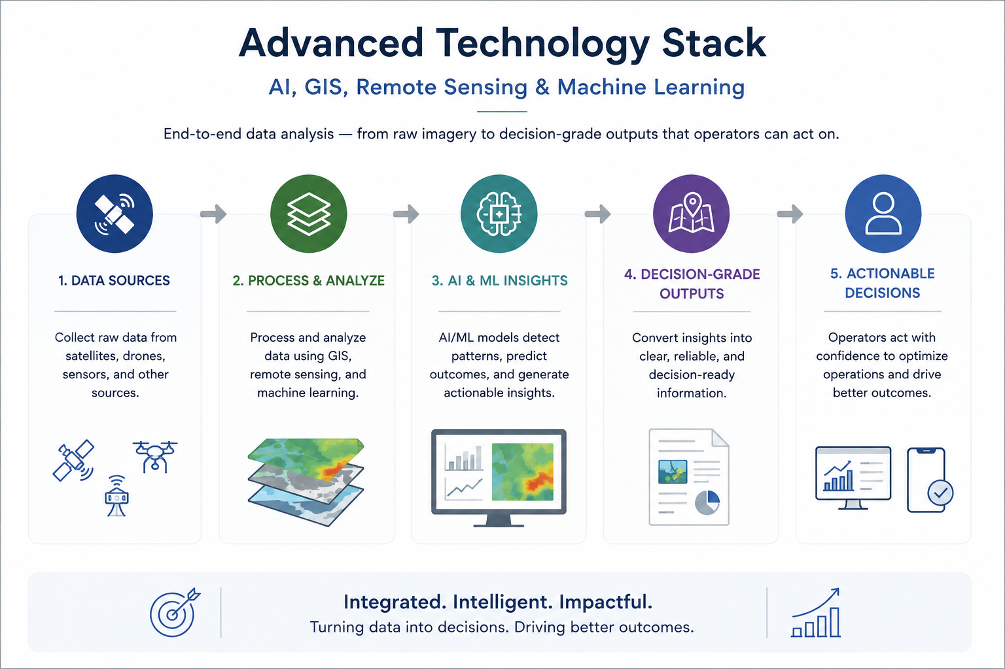
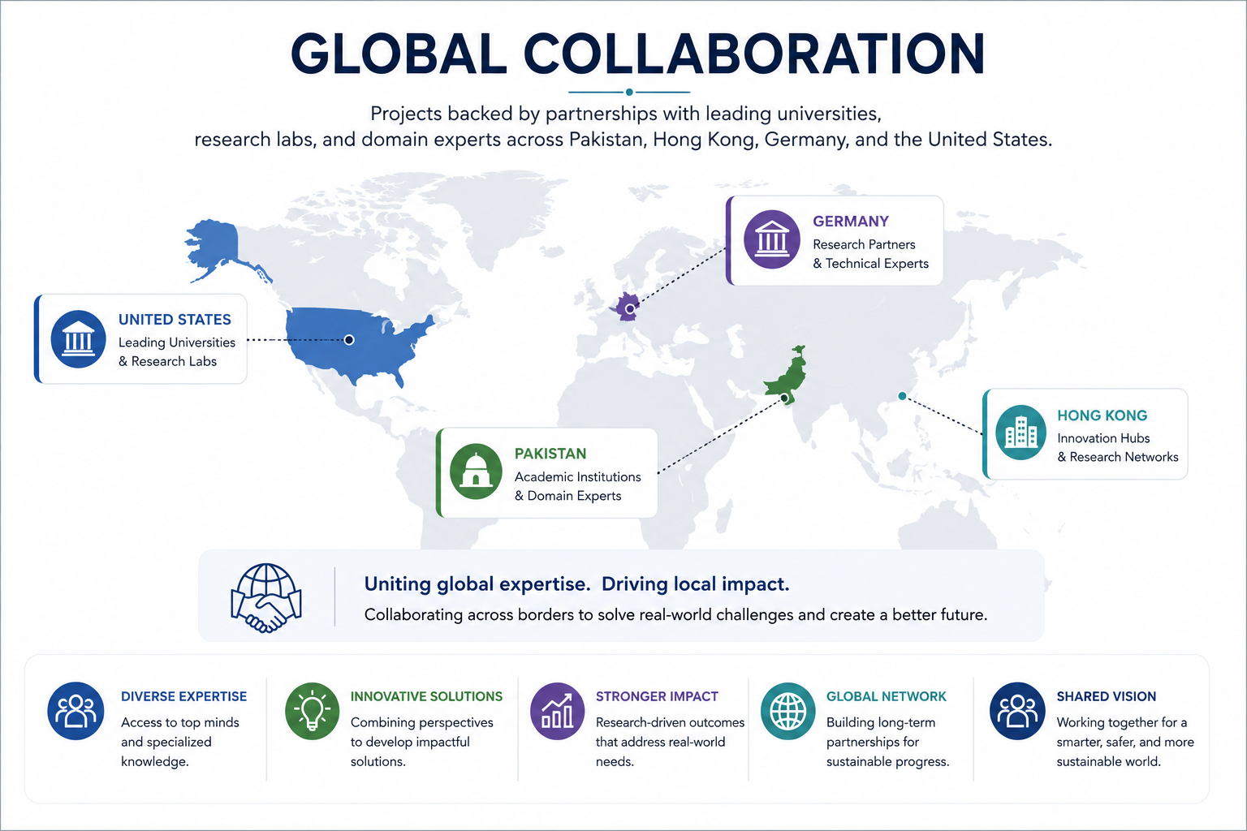
05 APPROACH
6 / 22
Three commitments shaping every engagement.
AI Geo Navigators · Climate Intelligence. Confident Decisions.
www.aigeo360.com

Slide 7
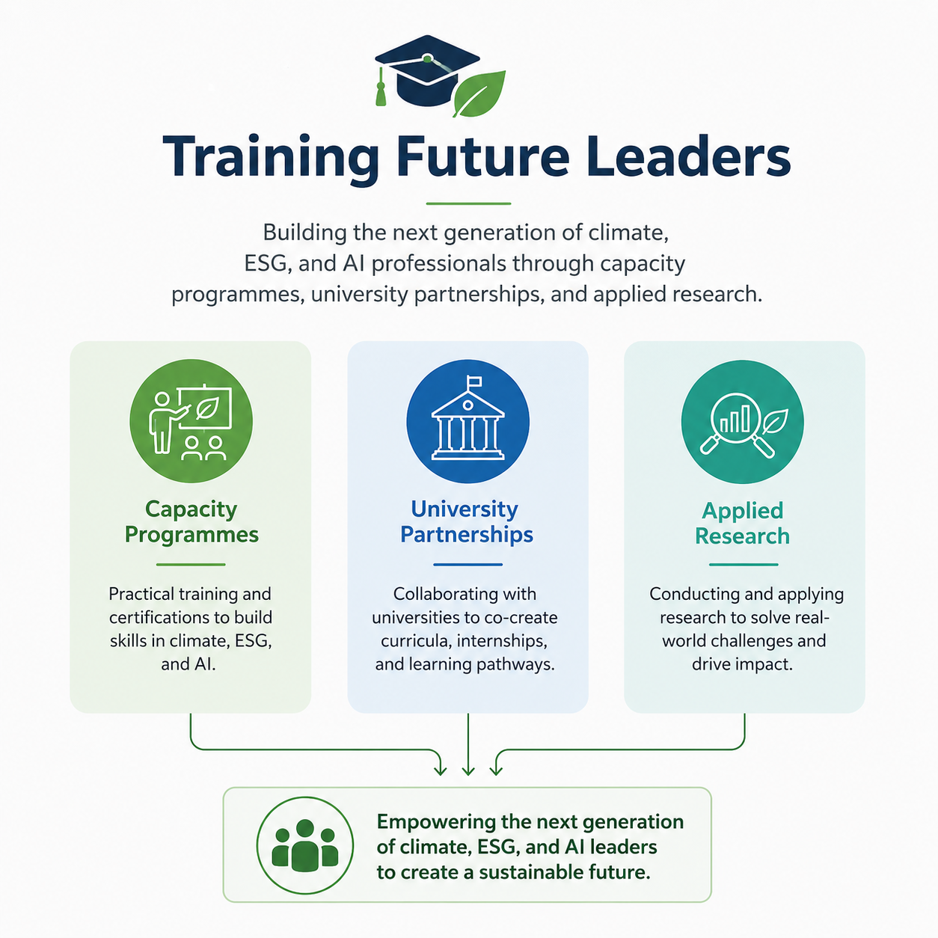
05 APPROACH
6 / 22
Three commitments shaping every engagement.
AI Geo Navigators · Climate Intelligence. Confident Decisions.
www.aigeo360.com

Slide 8
06 SOLUTIONS
7 / 22
Five integrated solution packages.
Modular offerings that combine to support resilience, sustainability, and operations.
Smart Urban & Rural Transformation
Climate Risk & Resilience Intelligence
Intelligent Decision Systems
Land-use mapping · Infrastructure planning · Web GIS portals · ESG analysis
Risk assessments · Hazard mapping · Early warning systems · Water resource modelling
AI & machine learning · Large language models · Predictive analytics · Real-time monitoring
Environmental & ESG Intelligence
Digital Engagement & Advocacy
Carbon reporting · Impact assessments · ESG dashboards · Biodiversity monitoring
Policy advocacy · Strategic communications · AI chatbots · Digital campaigns
AI Geo Navigators · Climate Intelligence. Confident Decisions.
www.aigeo360.com

Slide 9
07 TECHNOLOGY
8 / 22
From multi-source data to decision-grade outputs.
A three-step pipeline that turns raw signals into operational intelligence.
STEP 01
STEP 02
STEP 03
MULTI-SOURCE DATA
AI-ASSISTED PROCESSING
APPLICABLE OUTPUTS
Satellite imagery (optical & SAR)
Climate vulnerability & exposure modelling
Multi-hazard early warning portals
Aerial & drone surveys
ESG analytics & sustainability reporting
Geospatial decision support systems
Ground truth surveys
Automated image classification
Real-time asset & property visualisation
Climate & meteorological datasets
Spatiotemporal change detection
Climate-resilient infrastructure plans
Socio-economic & demographic data
Cloud-native geospatial databases
Predictive geospatial analytics
AI Geo Navigators · Climate Intelligence. Confident Decisions.
www.aigeo360.com

Slide 10
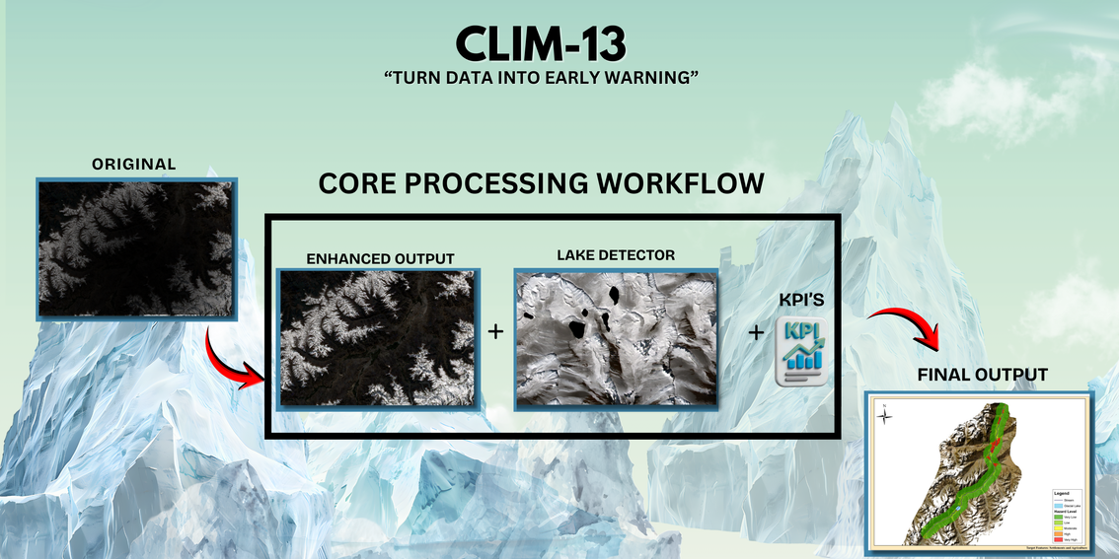
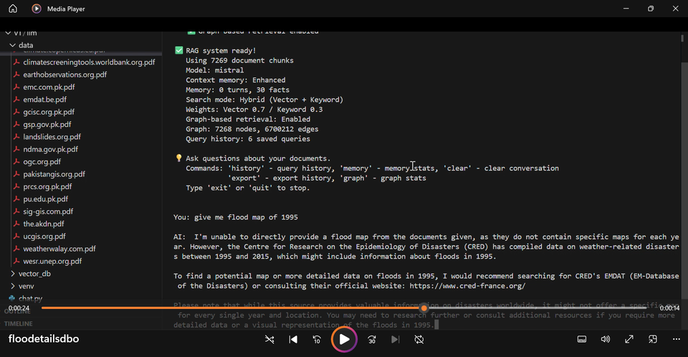
08 INNOVATION
9 / 22
Six proprietary AI engines.
In-house IP powering decisions across imagery, water, climate, and cities.
CLIM-13
Digital Brain of Organization
DBO
Glacial Lake Outburst Forecasting
RAG over internal documents and vetted science. Hallucination controls for high-stakes work. Plain-language insights.
Enhances imagery, detects glacial lakes, forecasts GLOF spread, generates risk-zone maps for early warning corridors.
AI Geo Navigators · Climate Intelligence. Confident Decisions.
www.aigeo360.com

Slide 11
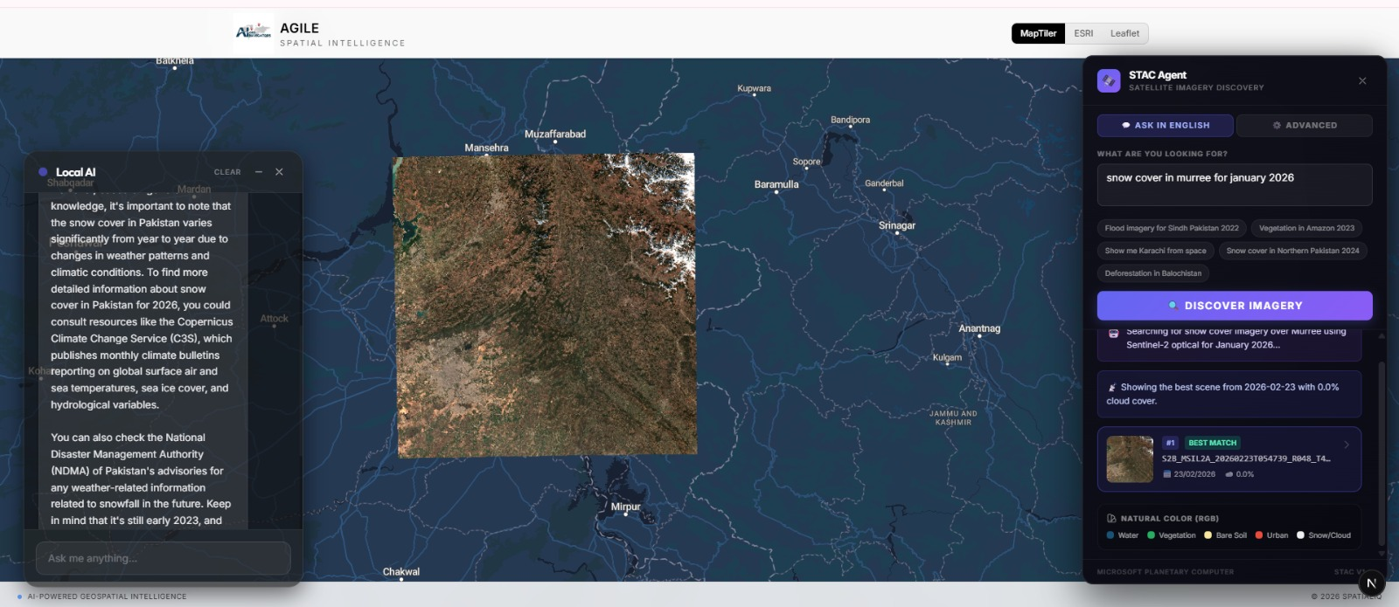
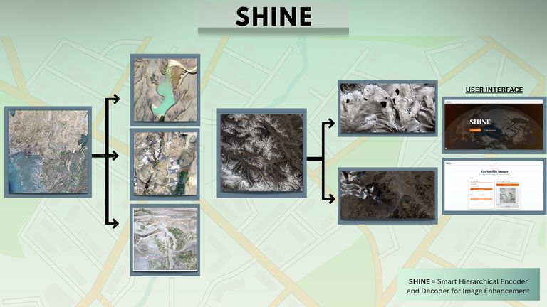
08 INNOVATION
9 / 22
Six proprietary AI engines.
In-house IP powering decisions across imagery, water, climate, and cities.
AGILE
Smart Hierarchical Encoder & Decoder
SHINE
Autonomous Geospatial Intelligence
Satellite image reconstruction up to 1-metre resolution. Optical and SAR inputs. Applied across agriculture, urban, and water.
Unified climate-tech platform with real-time vegetation, water, urban, and emissions layers. Map and chat-driven access.
AI Geo Navigators · Climate Intelligence. Confident Decisions.
www.aigeo360.com

Slide 12
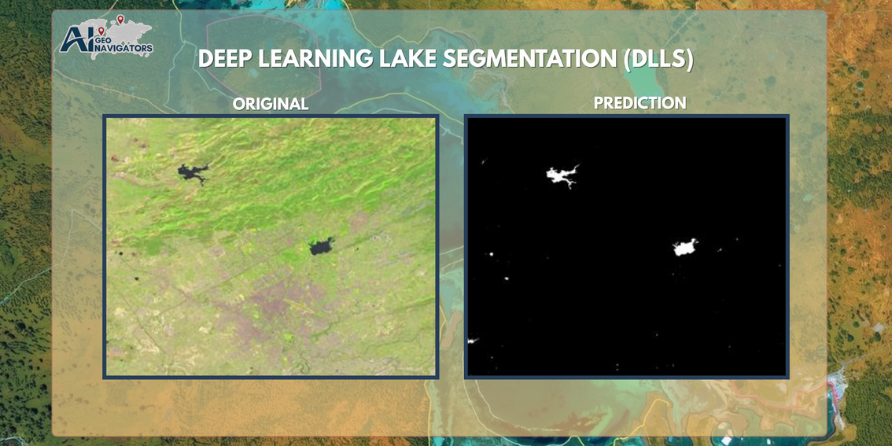
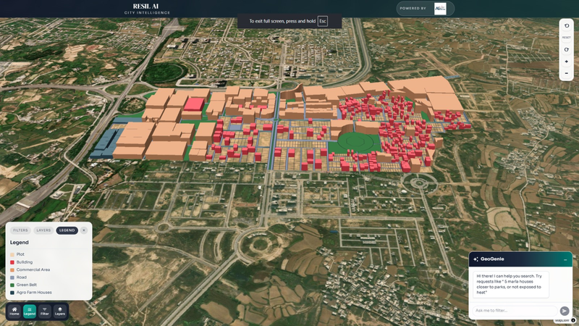
08 INNOVATION
9 / 22
Six proprietary AI engines.
In-house IP powering decisions across imagery, water, climate, and cities.
DLLS
Deep Learning Lake Segmentation
RESIL-AI
Urban Decision Engine
High-accuracy lake detection across regions. Scalable for operational decision-making. Feeds the CLIM-13 GLOF pipeline.
3D mapping fused with climate physics for parcel-level smart-city decisions. Block-by-block heat and risk modelling.
AI Geo Navigators · Climate Intelligence. Confident Decisions.
www.aigeo360.com

Slide 13
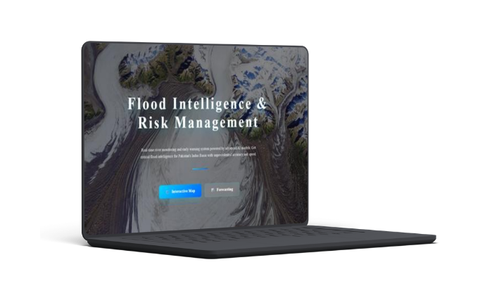
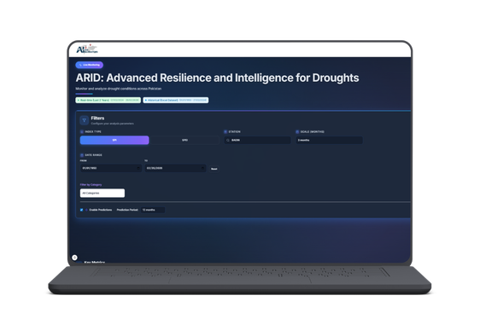
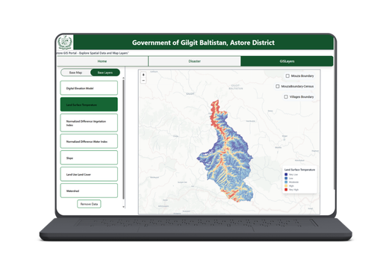
09 PRODUCTS
10 / 22
Operational SaaS, in production.
Live tools deployed across Pakistan's climate and disaster sectors.
ARID
FIRM
Astore Gov
Advanced Resilience & Intelligence for Droughts
Flood Intelligence & Risk Management
Interactive Dashboards
SPI and SPEI indices across Pakistan. Historical data back to 1950 plus live two-year telemetry. 12-month forecasts with CSV export.
Real-time monitoring of 40+ river stations across Pakistan's Indus Basin. AI early-warning, rainfall forecasts, predictive flood mapping.
GIS layers fused with field-collected telemetry. Damage assessment, vulnerable population identification, relief and evacuation planning.
AI Geo Navigators · Climate Intelligence. Confident Decisions.
www.aigeo360.com

Slide 14
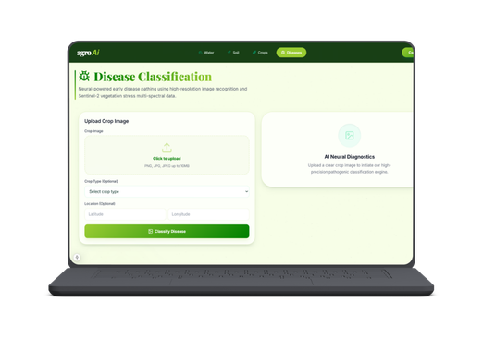
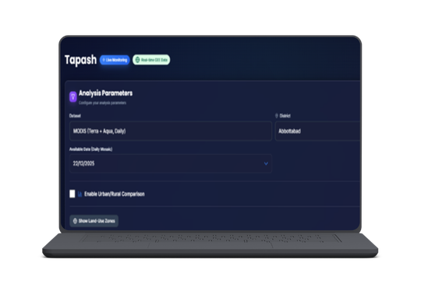
09 PRODUCTS
11 / 22
Operational SaaS, in production.
Precision agriculture and urban climate analytics.
AGRO AI
TAPASH
Precision Agriculture Intelligence
Urban Heat Island Analytics
NDVI/NDRE crop health, soil quality, AI-based disease detection from Sentinel-2. Yield forecasting under climate variability.
City-vs-rural UHI comparison. MODIS Terra + Aqua daily mosaics. Predictions with confidence bounds for planners and public health.
AI Geo Navigators · Climate Intelligence. Confident Decisions.
www.aigeo360.com

Slide 15
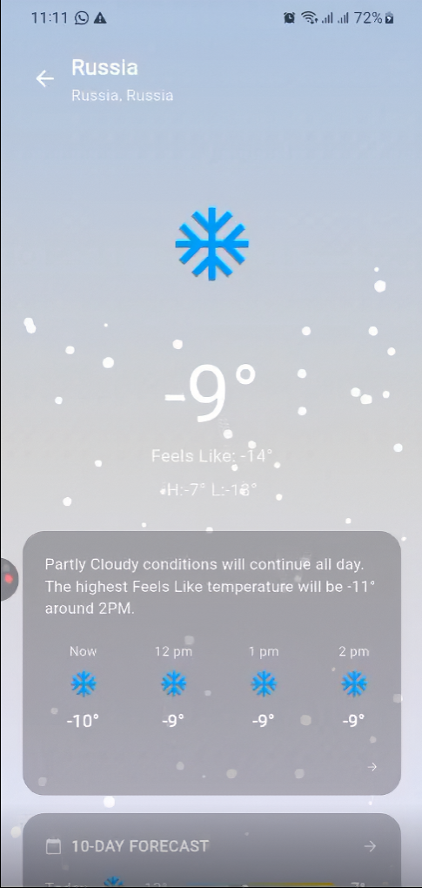
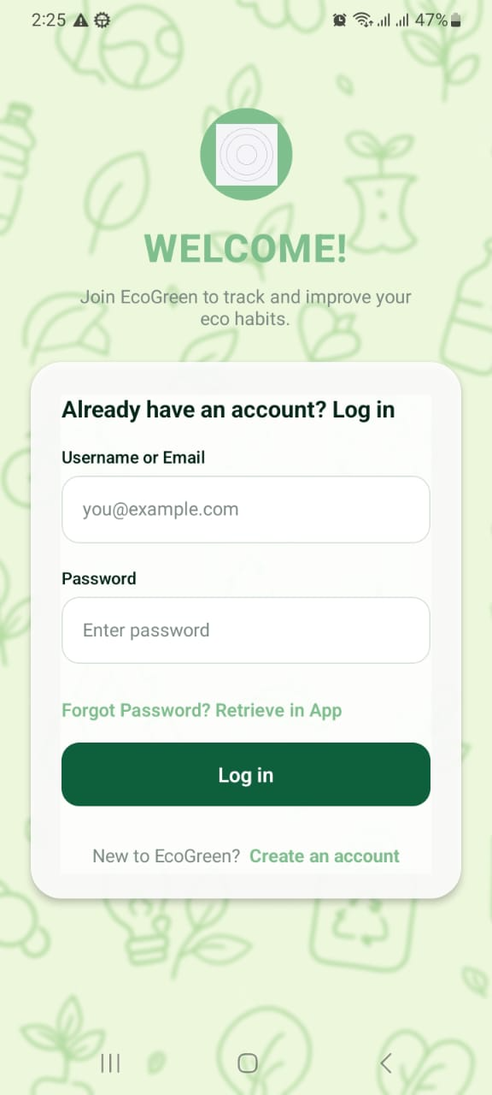
10 PALM-BASED SOLUTIONS
12 / 22
Consumer climate apps.
Mobile-first tools that put climate intelligence in everyone's hands.
WeatherHalo
ECOGREEN
Consumer barcode-scan app surfacing eco-scores and sustainable alternatives, with an AI assistant for daily green-living tips.
Hyper-local weather intelligence for operations, agriculture, and event planning. Detailed forecasts with smart location.
AI Geo Navigators · Climate Intelligence. Confident Decisions.
www.aigeo360.com

Slide 16
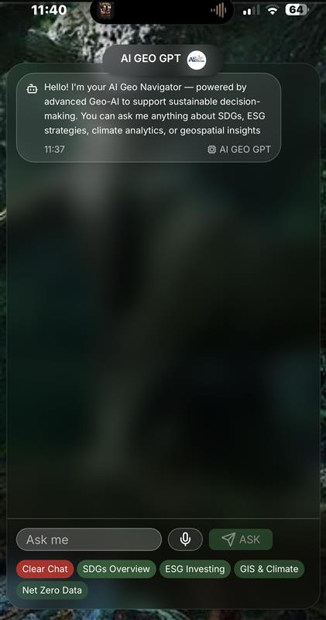
10 PALM-BASED SOLUTIONS
13 / 22
Mobile Geo-AI assistants.
Conversational climate intelligence and autonomous data agents.
AI Geo GPT
Mobile Geo-AI assistant for SDGs, ESG, and climate analytics. Hallucination controls, voice + NLP input, long-term memory.
AI Data Agents
Custom agents that ingest, query, and visualize geospatial and climate data — surfacing decisions instead of dashboards.
AI Geo Navigators · Climate Intelligence. Confident Decisions.
www.aigeo360.com

Slide 17
11 PROJECTS
14 / 22
Delivered & ongoing projects.
Public-sector and enterprise engagements across Pakistan.
15+
Delivered & ongoing projects
5+
Public-sector partnerships
3
International collaborations
Real Time Property Visualization for Mumtaz City
MHVRA Web Portal for District Administration Astore
Cadastral Mapping of Tehsil Daska, District Gujranwala
MHVRA-Muzaffarabad Pakistan Hazard Portal
THINKTANK GROUP Services — ERP Solution
Site suitability & contouring of solar and wind power sites
Carbon Credits: A Market-Based Approach to Reducing Emissions
Mangrove Reforestation in the Indus Delta
Cadastral Mapping of Yazman Tehsil, District Bahawalpur
Master Gas System Expansion Phase-III (ongoing)
GIS-Driven Environmental Impact Assessment
Environmental Impact Assessment programmes
AI Geo Navigators · Climate Intelligence. Confident Decisions.
www.aigeo360.com

Slide 18
12 CASE STUDY
15 / 22
Climate resilience in the Hindu Kush Himalaya.
Contributed to ICIMOD's regional publication on climate-resilient construction across South Asia.
OUR CONTRIBUTION
FEATURED IN
GIS & Remote Sensing
ICIMOD
Identifying safer housing zones from earth observation and terrain data.
Regional Publication
Disaster Risk Mapping
Hazard mapping across Gilgit-Baltistan, Swat, and Chitral.
Building for Climate Resilience in the Hindu Kush Himalaya
Resilient Settlement Planning
Climate-resilient layouts informed by exposure and vulnerability analysis.
AI Geo Navigators · Climate Intelligence. Confident Decisions.
www.aigeo360.com

Slide 19
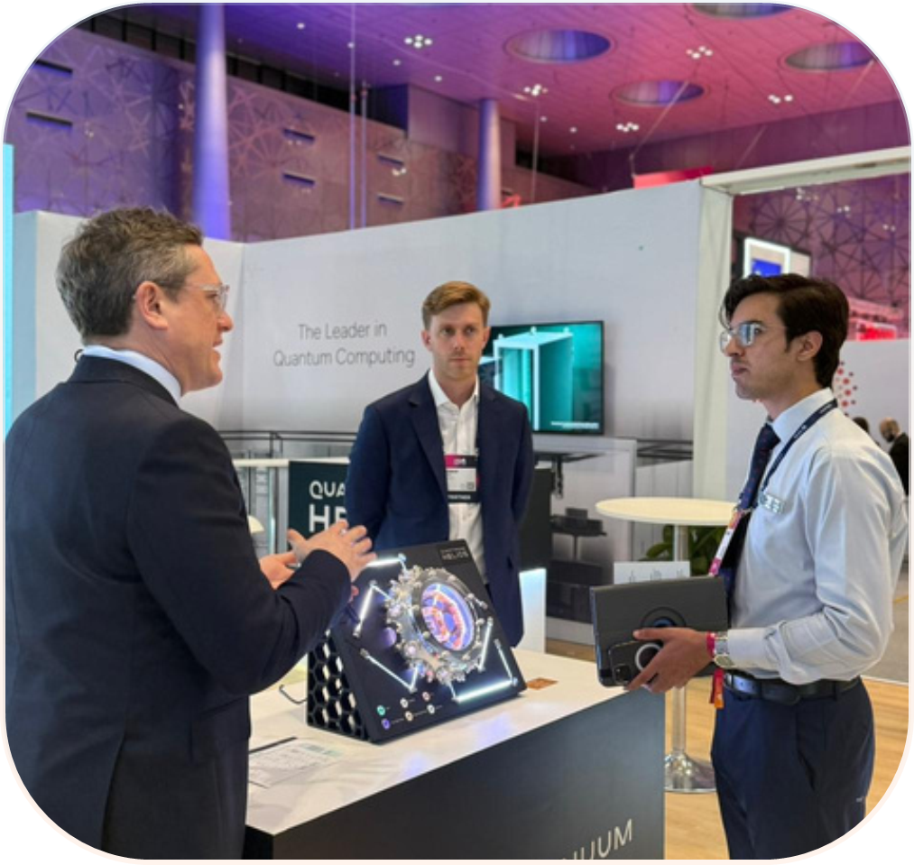
13 COMPUTE
16 / 22
Forward-looking compute infrastructure.
Exploring partnerships to scale advanced AI workloads on geospatial data.
RESEARCH DIRECTION · QUANTUM COMPUTING
Quantum Access
Investigating quantum-computing partnerships including Quantanium for next-generation processing and advanced AI inference on complex geospatial datasets — a research direction, not a current deployment.
AI Geo Navigators · Climate Intelligence. Confident Decisions.
www.aigeo360.com

Slide 20
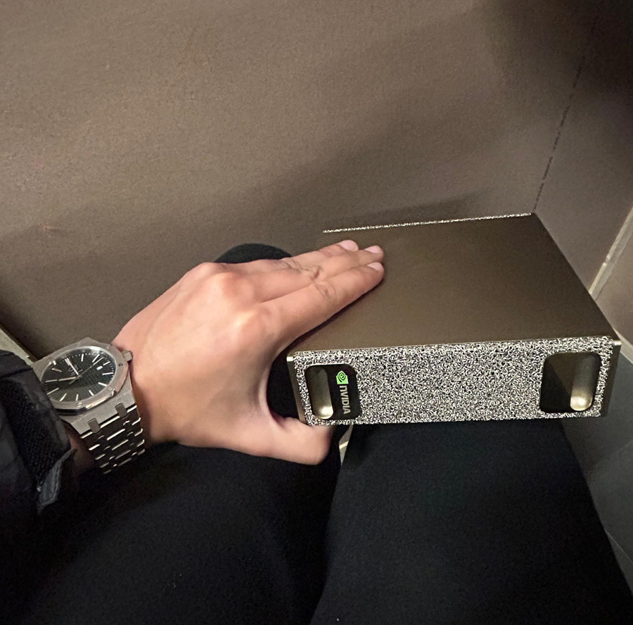
13 COMPUTE
17 / 22
Forward-looking compute infrastructure.
Exploring partnerships to scale advanced AI workloads on geospatial data.
EXPLORATION · HIGH-PERFORMANCE GPU
NVIDIA AI Systems
Targeting NVIDIA AI infrastructure for accelerated model training, image processing, and real-time inference on geospatial workloads. Engagement under exploration with Bracewell Technology.
AI Geo Navigators · Climate Intelligence. Confident Decisions.
www.aigeo360.com

Slide 21





14 TEAM
18 / 22
Our core team.
Climate, geospatial, and AI specialists across Pakistan and the United States.
30+
Professionals
4
Offices: Islamabad · Gilgit · Lahore · Delaware
8
Scientific Advisory Board members
CEO & Founder
Co-Founder
Chief Operating Officer
Coordination Manager, Global Office
Coordinator, Global Office
ASIM JAVID
ANMOL ASIM
OWAIS ALI
UZMA JAHAN
MANSOOR ADIL
AI Geo Navigators · Climate Intelligence. Confident Decisions.
www.aigeo360.com

Slide 22
15 ADVISORY BOARD
16 / 22
Scientific Advisory Board.
Independent oversight from academic and industry leaders across four continents.
Dr. Junaid Ahmad
Dr. Sajjad Muhammad
Dr. Hammad Gilani
Dr. Khalid Mehmood
Ph.D. Civil Engineering (Water Resources)
Scientific Advisor (R&D), Chinese University of Hong Kong
Research Scientist, New Mexico State University
Bioenergy & Circular Economy Expert, Germany
Dr. Saulat Hussain
Dr. Jahanzeb Khan
Dr. Atif Akbar
Alamgir Khan Gandapur
Professional Member, GB Climate Change Forum
Asst. Prof. (TTS), Institute of Geology, UAJK
Professor of Statistics, BZU Multan
Technical Expert, Carbon Project Development
AI Geo Navigators · Climate Intelligence. Confident Decisions.
www.aigeo360.com

Slide 23
15 TEAM COMPOSITION
16 / 22
Research, development & geospatial team.
The specialists delivering projects day to day.
RESEARCH & DEVELOPMENT
Musfirah Aakash
Uzma
Mahnoor Chaudhry
Syeda Fatima
Program Manager
Agriculturalist
Environmentalist
Environmentalist
AI & GEOSPATIAL TEAM
Mudassir Sohail
Abdur Rehman
Danish Zahoor
Ali Khan
GIS Supervisor
GIS Team Lead
Tech Supervisor
Tech Team Lead
AI Geo Navigators · Climate Intelligence. Confident Decisions.
www.aigeo360.com

Slide 24
16 RECOGNITION
17 / 22
Presence, awards & funding.
Visibility, validation, and growth capital.
PRESENCE
AWARDS & ACHIEVEMENTS
FUNDING (SEED)
Toronto Climate Week
Future Leaders Award
Status: In progress
Baku Climate Week
NIC Cohort 3 — Selected
Seed funding round in active development
WebSummit Qatar 2026
9th — AI Wrapper Competition, Islamabad
Allocation: R&D, SaaS scale-up, talent
ITCN Asia 2026, Lahore
Community-Based GLOF Forecasting (2026–2030)
Strategic partnerships under exploration
DataFest 2025
Featured in ICIMOD HKH Publication
DEWTE Expo 2025 (NDMA)
Disaster Resilience & Climate Risk Management
3rd Intl. Conf. on Precision & Sustainable Agriculture
LOA with NDMA
AI Geo Navigators · Climate Intelligence. Confident Decisions.
www.aigeo360.com

Slide 25
17 LEGAL & COMPLIANCE
18 / 22
Fully registered. Internationally recognised.
Two legal entities, eight active registrations, ready for public and international contracting.
PAKISTAN
AI Geo Navigators (Private) Limited
SECP Incorporation (CUIN)
0266827 · Inc. 20 Aug 2024
FBR NTN (Tax ID)
E560834 · Filer Active
GST / STRN
32-77-8763-528-24
PSEB IT Registration
Z-25-13039/25 · Feb 2026 – Jan 2027
ICCI Chamber Membership
CM-6743 · Valid to 31 Mar 2026
US NAICS CODES 541370 Surveying & Mapping · 541620 Environmental Consulting
AI Geo Navigators · Climate Intelligence. Confident Decisions.
www.aigeo360.com

Slide 26
17 LEGAL & COMPLIANCE
18 / 22
Fully registered. Internationally recognised.
Two legal entities, eight active registrations, ready for public and international contracting.
UNITED STATES
AI Geo Navigators LLC
Delaware File Number
10365333 · Inc. 13 Oct 2025
IRS EIN (Tax ID)
38-4372091
SAM.gov UEI
GYJGZEY4TRQ3
NATO NCAGE Code
STDA7
EU PIC (Funding Portal)
867589923 · OID 0266827
US NAICS CODES 541370 Surveying & Mapping · 541620 Environmental Consulting
AI Geo Navigators · Climate Intelligence. Confident Decisions.
www.aigeo360.com

Slide 27
18 WHY US
19 / 22
Why AI Geo Navigators.
Six reasons clients pick us over generalist consultancies and single-product vendors.
01
Climate-first focus
02
Full-stack capability
03
Scientific rigor
Every product and service is built on a climate-intelligence foundation — not retrofitted from generic GIS work.
From earth observation to AI agents to dashboards — one team, one architecture, end-to-end accountability.
Methods grounded in peer-reviewed science with independent oversight from an 8-member advisory board.
04
Productised IP
05
Compute access
06
Ethical, transparent
Six in-house engines and five SaaS products that compound across engagements and reduce time-to-insight.
GPU and quantum partnerships under exploration to unlock workloads competitors cannot run.
Open methods, source attribution, hallucination controls, and reproducible outputs by default.
AI Geo Navigators · Climate Intelligence. Confident Decisions.
www.aigeo360.com

Slide 28
19 ENGAGEMENT
20 / 22
How to work with us.
Three engagement models: from rapid pilots to multi-year transformation programmes.
PILOT
PROGRAMME
TRANSFORMATION
Rapid pilot
Multi-phase build
Long-term partnership
4–8 weeks
3–9 months
12+ months
Bounded proof of value on a single use case. Data discovery, model build, and a delivered dashboard with handover documentation.
Production-grade deployment of one or more SaaS modules. Integration with client data sources, training, and ongoing support.
Full climate-intelligence capability build-out — engines, dashboards, data pipelines, capacity building, and joint research.
AI Geo Navigators · Climate Intelligence. Confident Decisions.
www.aigeo360.com

Slide 29
20 OFFICES
21 / 22
Where we work from.
Implementation and R&D in Pakistan, contracting and IP in the United States.
Regional HQ · Pakistan
Pakistan
Pakistan
Global HQ · USA
ISLAMABAD
GILGIT
LAHORE
LEWES, DE
Implementation & R&D
Field & GLOF programmes
Cadastral & urban projects
Contracting & IP
Building 63, 1st Floor, Service Road, I-8/4, Islamabad
Northern operations & Hindu Kush Himalaya work
Urban transformation and land-information work
16192 Coastal Hwy, Lewes, DE 19958, United States
AI Geo Navigators · Climate Intelligence. Confident Decisions.
www.aigeo360.com

Slide 30
GET IN TOUCH
Let's map your
next decision.
From hazard intelligence to ESG dashboards — bring us a problem and we'll bring you the data, the model, and the dashboard.
WEBSITE
EMAIL
PHONE
LINKEDIN
www.aigeo360.com
info@aigeo360.com
+92 51 8740600
linkedin.com/company/ai-geo-navigators
THANK YOU
STRUCTURE · EVIDENCE · SIGNAL · IMPACT

