Slide 1
GEO
NAVIGATORS
Mapping Data & Business Solutions
AI Geo Navigators is redefining how the world is mapped with intelligence, sustainability, and ethical transparency at every step.

Slide 2
ABOUT US
  AI Geo Navigators transforms climate and environmental data into actionable insights through Geospatial-AI, GIS, remote sensing, and advanced analytics.
  We enable climate adaptation, disaster risk reduction, ESG reporting, sustainability strategy, global collaboration, and capacity building for the next generation of climate and AI leaders.

Slide 3

VISION
MISSION
  To be the leading force in geospatial innovation,
  Empowering communities and organizations through intelligent mapping, sustainable data solutions, and digital transformation
  Creating a resilient and informed world.
  To deliver cutting-edge geospatial and digital solutions
  Data-driven decision-making
  Enhance climate resilience
  Support sustainable development through AI-driven innovation, collaboration, and capacity building across diverse sectors and communities.

Slide 4
EVIDENCE THAT RESILIENCE & EARLY ACTION WORK CLIMATE RISK IS COSTLY BUT PREVENTION IS PROVEN TO WORK.
Global Evidence:
1 hour of early warning can reduce disaster losses by up to 30% (UNDRR)
Every $1 invested in resilience saves $4–$10 in avoided losses (World Bank / UN)
Countries with strong early warning systems experience 8x lower disaster mortality rates (WMO)
Climate-related disasters have increased 5-fold over the past 50 years (WMO)
Annual global climate disaster losses exceed $300–400 billion
Financial & Economic Case
Climate risks could reduce global GDP by up to 10–18% by 2050 without adaptation (Swiss Re)
Infrastructure designed with climate risk integration can reduce lifecycle costs by up to 20–30%
Early drought monitoring improves agricultural yield stability by 15–20% in vulnerable regions
What This Means for Stakeholders
Investing in:
Predictive monitoring
Risk-informed planning
Data-driven decision systems
Is not an expense, It is economic protection.

Slide 5
AI GEO NAVIGATORS’S ROLE
AI Geo Navigator supports proactive resilience by delivering:
Real-time hazard intelligence
Predictive climate risk modeling
Exposure and impact analytics
Decision-ready dashboards
Turning risk awareness into measurable risk reduction.

Slide 6




OUR CORE TEAM
ASIM JAVED
(CEO & Founder)
OWAIS ALI
(Chief Operating Officer)
UZMA JAHAN
(Coordination Manager, Global Office)
MANSOOR ADIL
(Coordinator, Global Office)

Slide 7
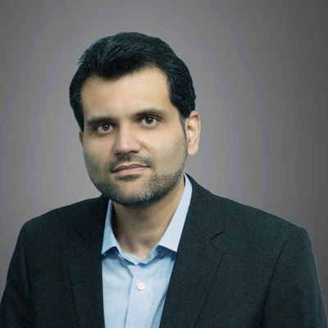
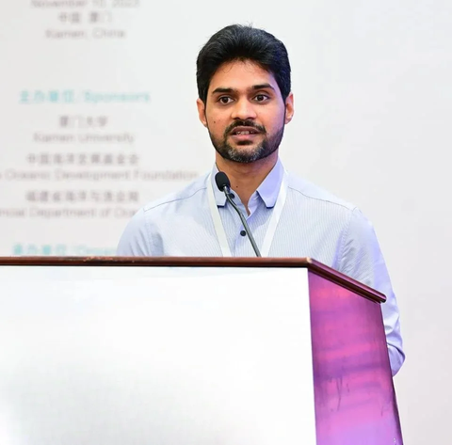
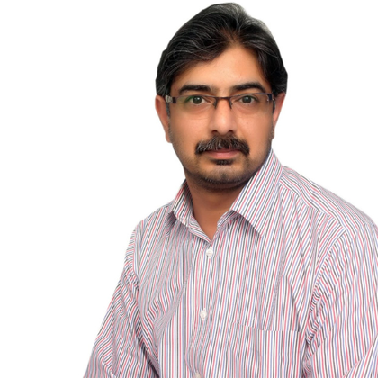
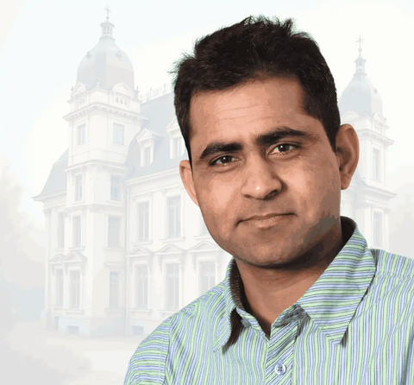
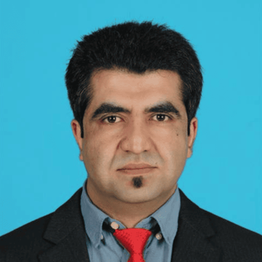
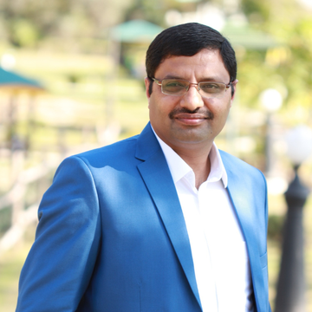
SCIENTIFIC ADVISORY BOARD
Dr. Junaid Ahmad
Ph.D. Civil Engineering (Water Resources)
Dr. Sajjad Muhammad
Scientific Advisor (Research and Development) Research Assistant Professor, The Chinese University of Hong Kong, Hong Kong SAR
Dr. Hammad Gilani
Research Scientist at Plant and Environmental Sciences, New Mexico State University.
Dr. Khalid Mehmood
Expert in Biomass Resources Management, Bioenergy and Circular Economy, Germany
Dr. Saulat Hussain
Professional Member of GB Climate Change Forum
Dr. Jahanzeb Khan
Assistant Professor (TTS), Institute of Geology, University of Azad Jammu & Kashmir, Muzaffarabad

Slide 8



FUNDRAISING (SEED fund)
45%
R&D
30%
25%
SALES
TEAM BUILDING

Slide 9
OUR INTEGRATED SOLUTION PACKAGES
ENVIRONMENTAL
TRANSFORMATION & ESG
INTELLIGENCE
SMART URBAN
& RURAL TRANSFORMATION
CLIMATE RISK & RESILIENCE INTELLIGENCE
INTELLIENCE DECISION SYSTEM
DIGITAL ENGAGEMENT
& ADVOCACY INTELLIGENCE
  Land Use Mapping
  Infrastructure Planning
  Language
  Web GIS Portals
  ESG Analysis
  Climate Risk Assessments
  Hazard Mapping
  Early Warning Systems
  ESG Analysis & Reporting
  Water Resource Modeling & Management
  Al & Machine Learning
  Large Language Models
  Data Integration
  Predictive Analytics
  Real-Time Monitoring
  Carbon Reporting
  Impact Assessments
  ESG Dashboards
  Biodiversity Monitoring
Policy Advocacy
Strategic
Communications
Al Chatbots
Digital Campaigns

Slide 10
APPLIED TECHNOLOGY
Multi-source Data
AI-Assisted Processing
Applicable Outputs
  Satellite Imagery
  Aerial & Drone Surveys
  Ground Truth Surveys
  Climate & Meteorological Datasets
  Socio-economic & Demographic Data
  Climate Vulnerability & Exposure Modeling
  ESG Analytics & Sustainability Reporting
  Automated Image Classification & Feature Extraction
  Spatiotemporal Change Detection & Monitoring
  Strategic Environmental & Social Impact Assessments
  Cloud-native Geospatial Databases & Web GIS
  Cadastral Mapping & Land Digitization
  Multi-Hazard Early Warning & Risk Portals
  Geospatial Decision Support Systems
  Real-Time Asset & Property Visualization
  Climate Resilient Infrastructure Planning
  Predictive Geospatial Analytics & Scenario Modeling

Slide 11












PROJECTS
Environment Management Plan-MASTER GAS SYSTEM EXPANSION PHASE-III PKG1- Upgrade Existing BGCS1,3 & 5 (on-going)
GIS-Driven Environmental Impact Assessment
Real Time Property Visualization For Mumtaz City
MHVRA Web Portal for District Administration Astore
Cadastral Mapping of Tehsil Daska, District Gujranwala
MHVRA-Muzaffarabad. Pakistan Hazard Portal
THINKTANK GROUP Services - ERP Solution
Site suitability, assessment and contouring of solar and wind power sites
Carbon Credits: A Market-Based Approach to Reducing Emissions
Evaluation of Different Approaches to Mangrove Reforestation and Rehabilitation in the Indus Delta
Cadastral Mapping of Yazman Tehsil, District Bahawalpur

Slide 12
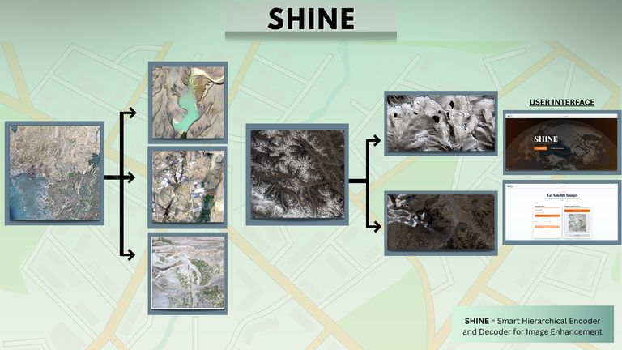
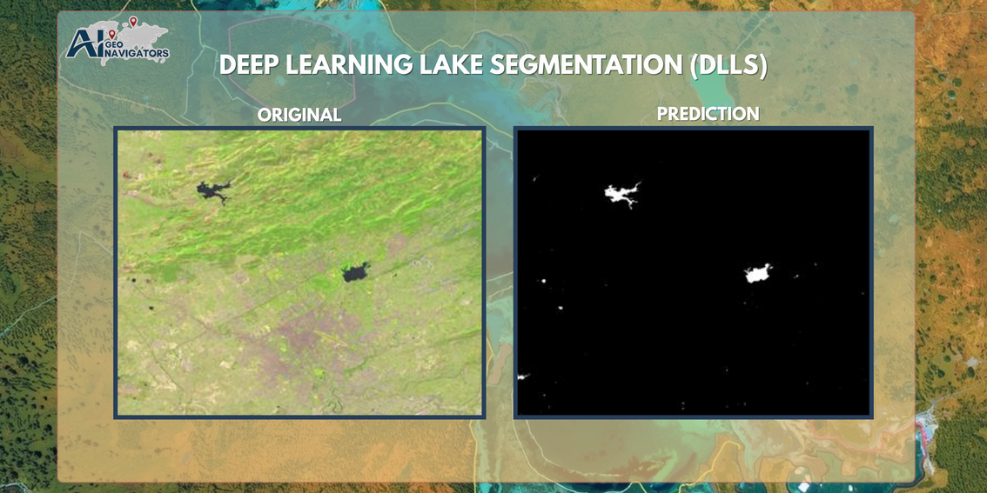
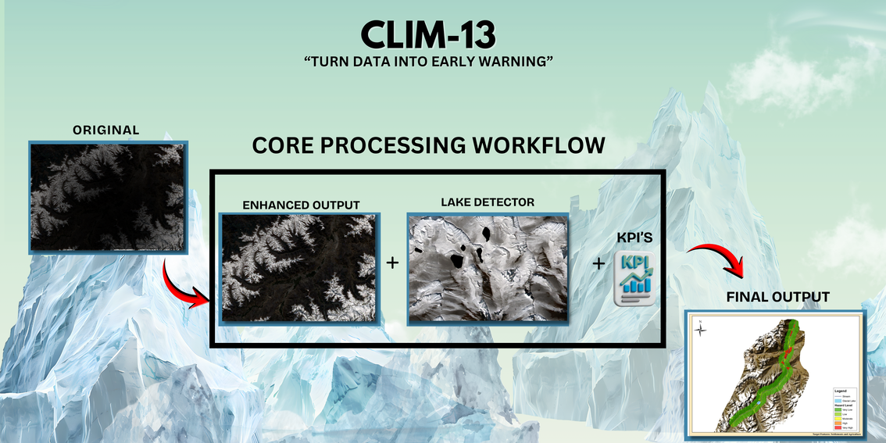
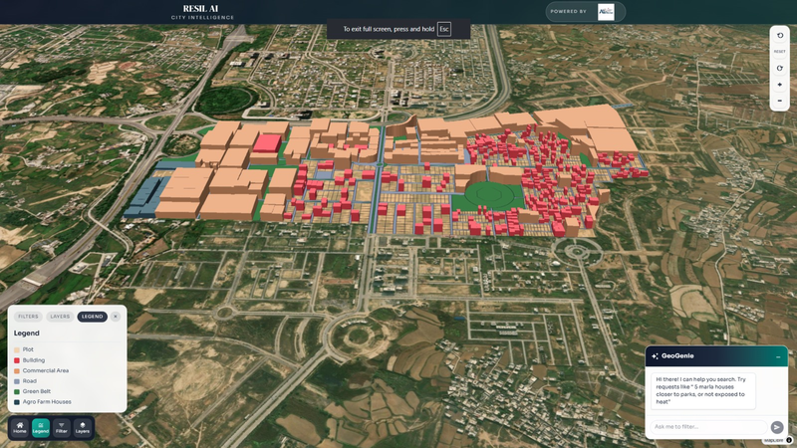
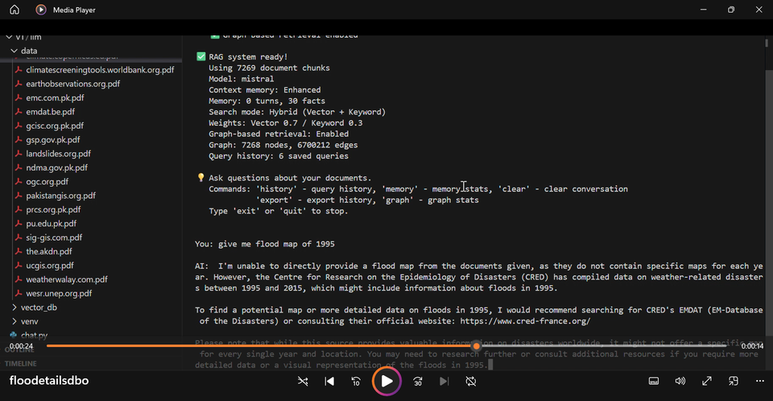
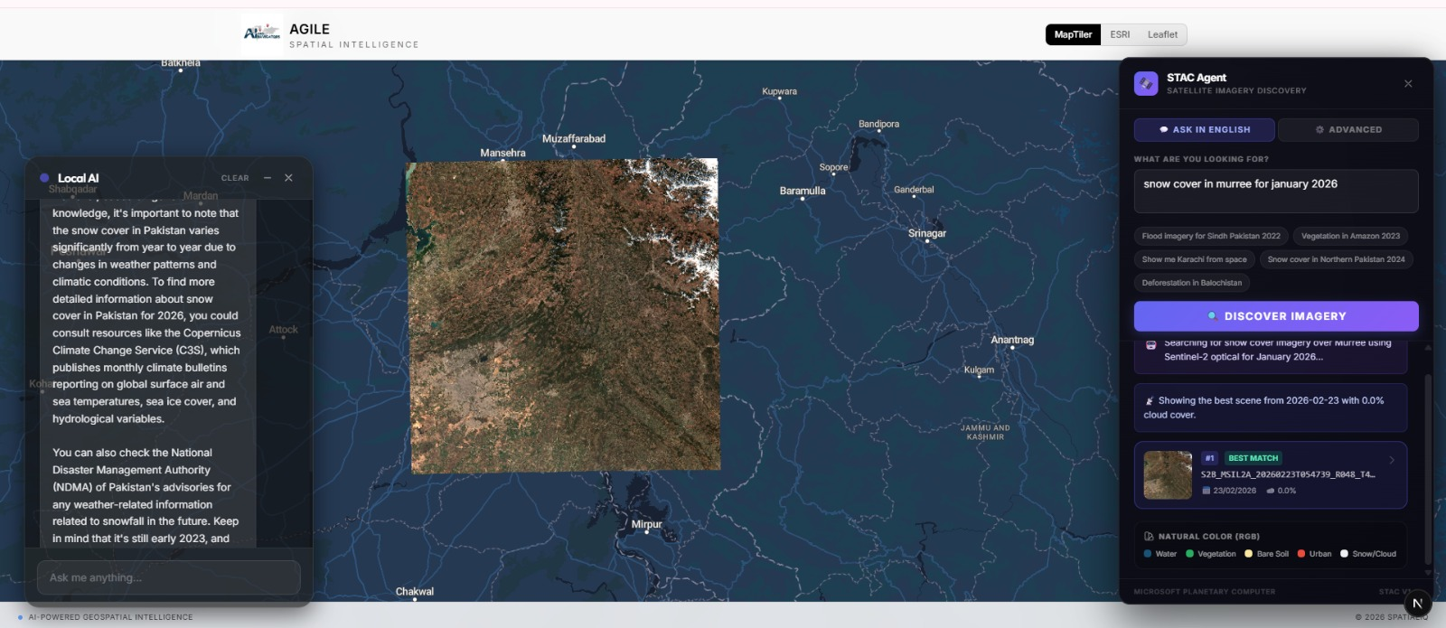
OUR IN-HOUSE INNOVATIONS
SHINE
Smart Hierarchical Encoder & Decoder For Image Enhancement
DLLS
Deep Learning Lake Segmentation
CLIM-13
Turning Data into Early Warning
AGILE
Autonomous Geospatial Intelligence & Learning Engine
RESIL-AI
Urban Decision Engine
DBO
Digital Brain of Organization

Slide 13
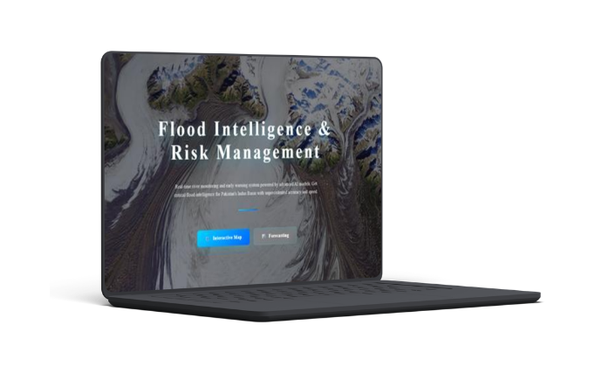
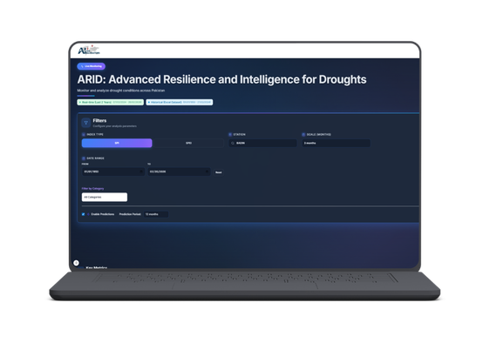
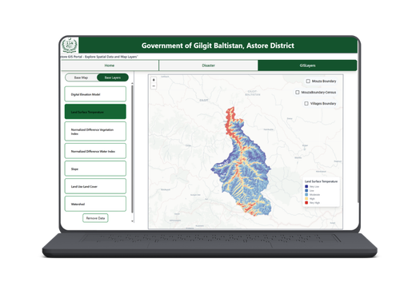
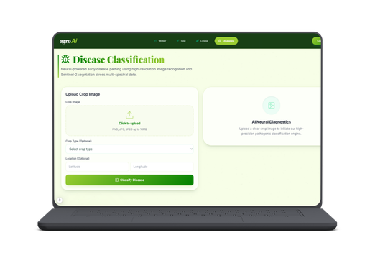
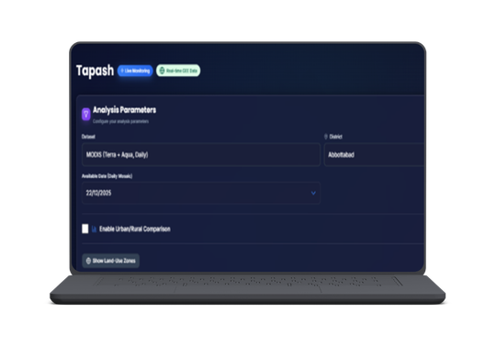
FIRM
(Flood Intelligence & Risk Management)
SaaS PRODUCTS
ARID
(Advanced Resilience and Intelligence for Droughts)
Astore Gov Interactive Dashboards
AGRO AI
TAPASH

Slide 14
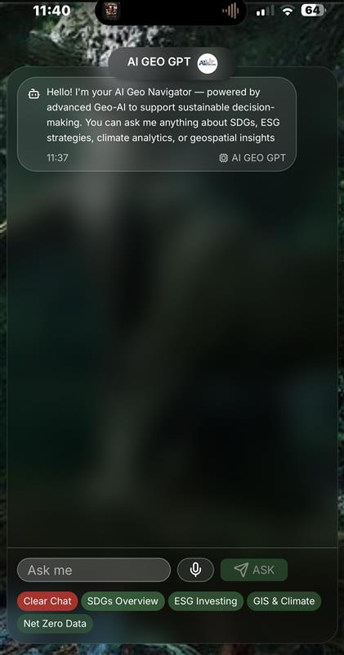
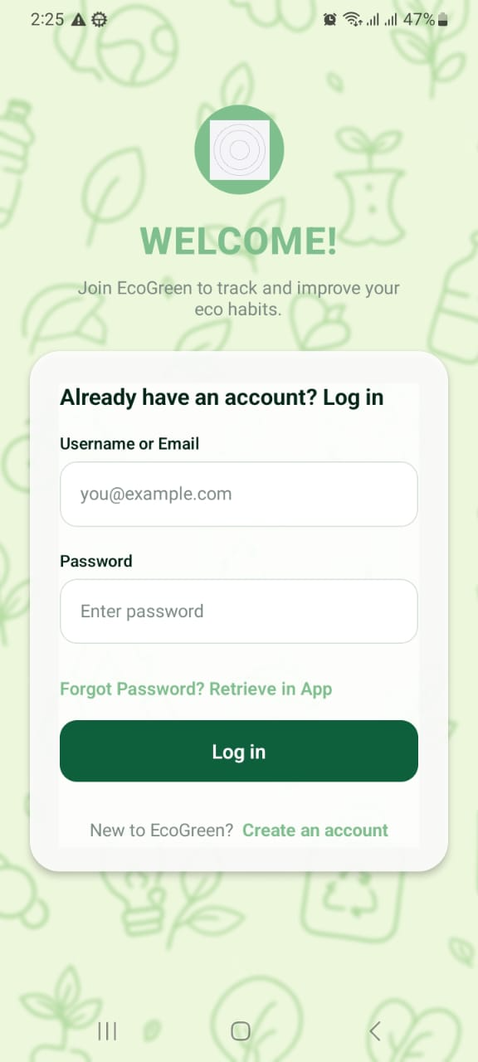
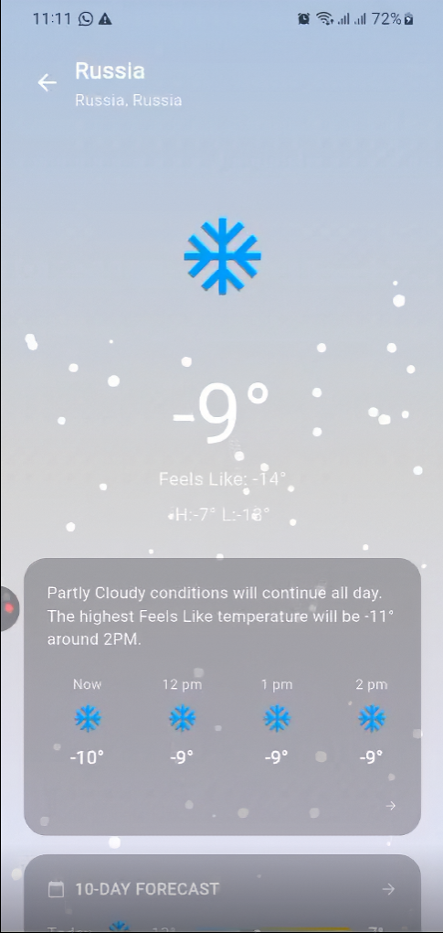

PALM-BASED SOLUTIONS
NOVO
EcoGreen
WeatherHalo

Slide 15

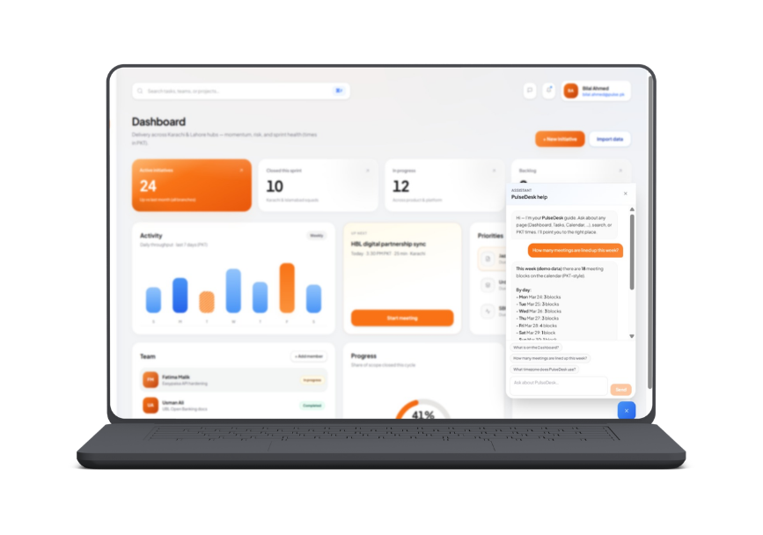
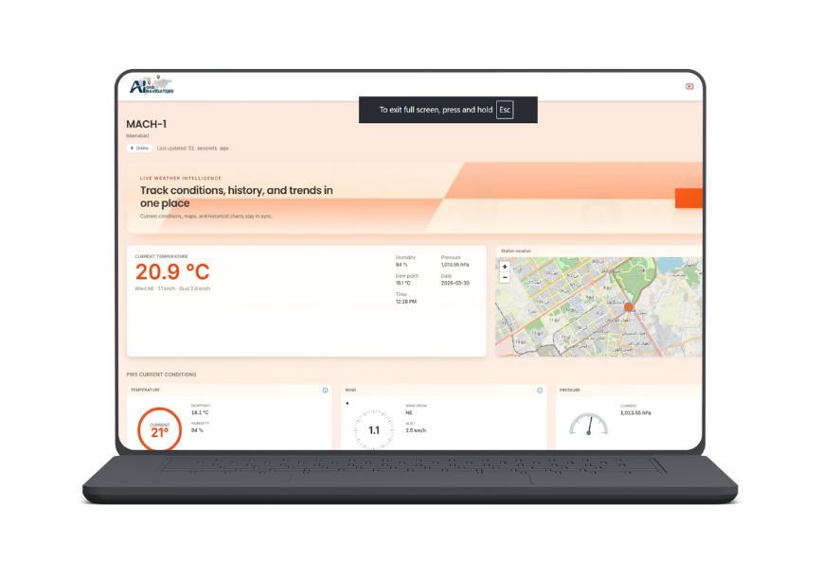
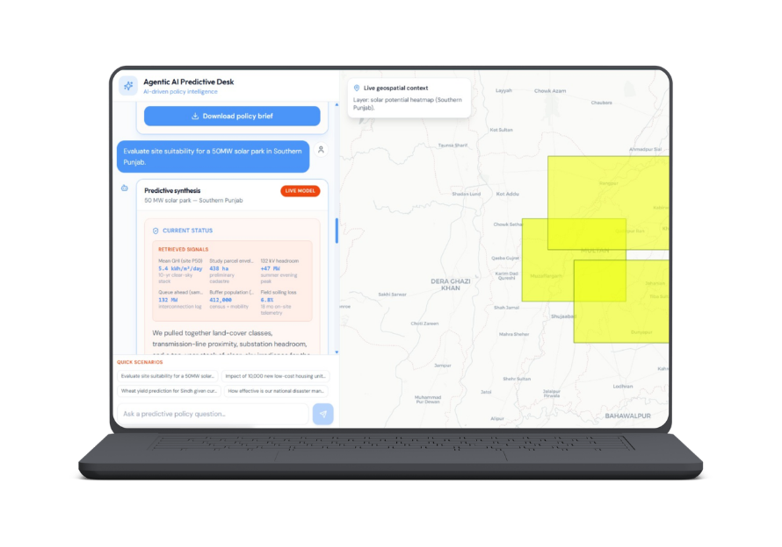
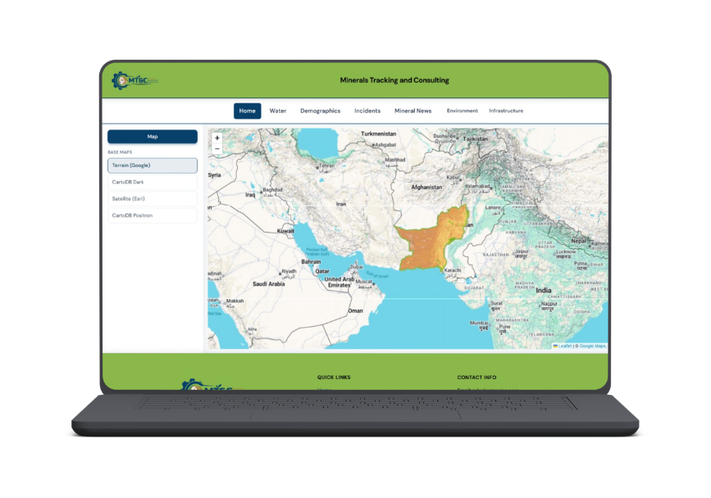
DATA & DASHBOARDS
AI Powered Data Agents

Slide 16
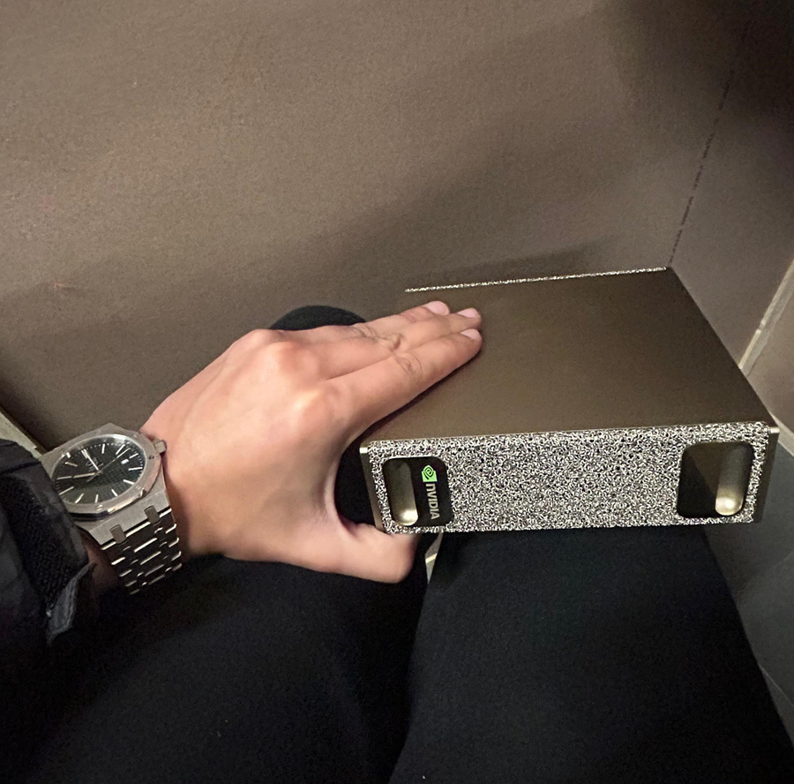
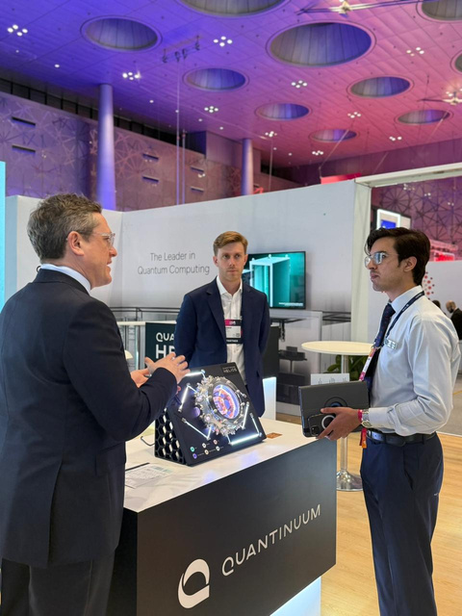
ON TECHNOLOGICAL FRONTIERS
NVDIA AI COMPUTERS OF BRACEWELL TECHNOLOGY GPUs
ACCESS TO QUANTANIUM QUANTUM COMPUTING
High-performance NVIDIA AI systems using Bracewell Technology GPUs to accelerate AI workloads.
Secure access to Quantanium quantum computing for faster data processing and advanced AI insights.

Slide 17





ACADEMIA
OUR COLLABORATOR
Our collaborators are the foundation of our growth, teaching us:
  values of resilience
  responsibility, and
  foresight
Like sustainable practices, their guidance inspires
  long-term thinking
  ethical choices, and
  meaningful impact in both personal and professional life.

Slide 18








INDUSTRIAL
OUR COLLABORATOR
Our collaborators are the foundation of our growth, teaching us:
  values of resilience
  responsibility, and
  foresight
Like sustainable practices, their guidance inspires
  long-term thinking
  ethical choices, and
  meaningful impact in both personal and professional life.

Slide 19
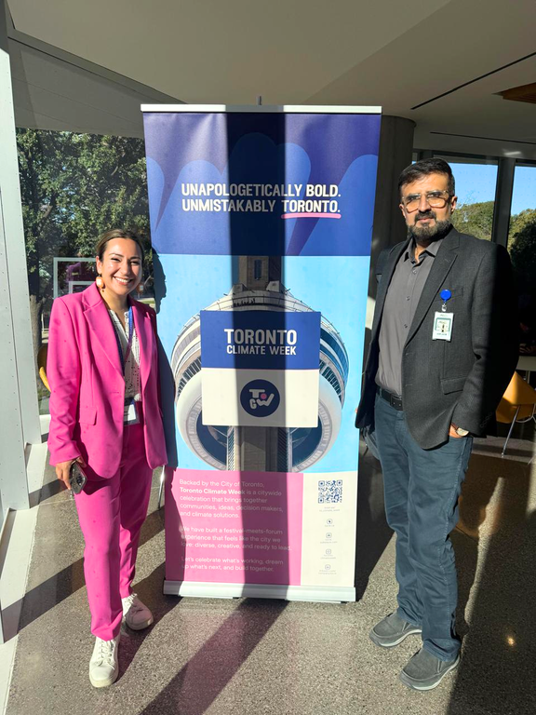

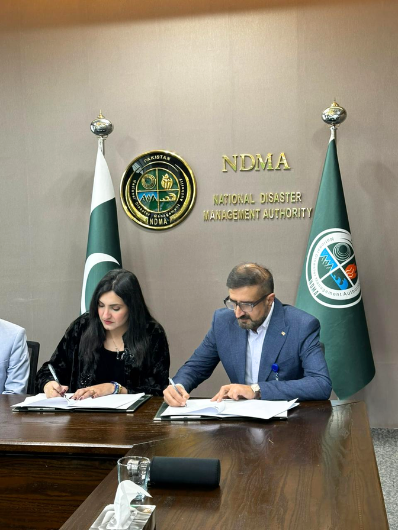

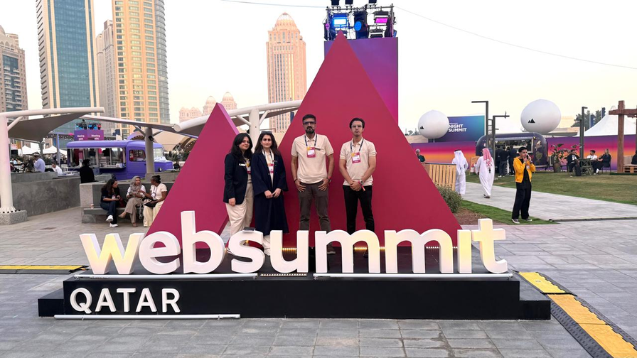
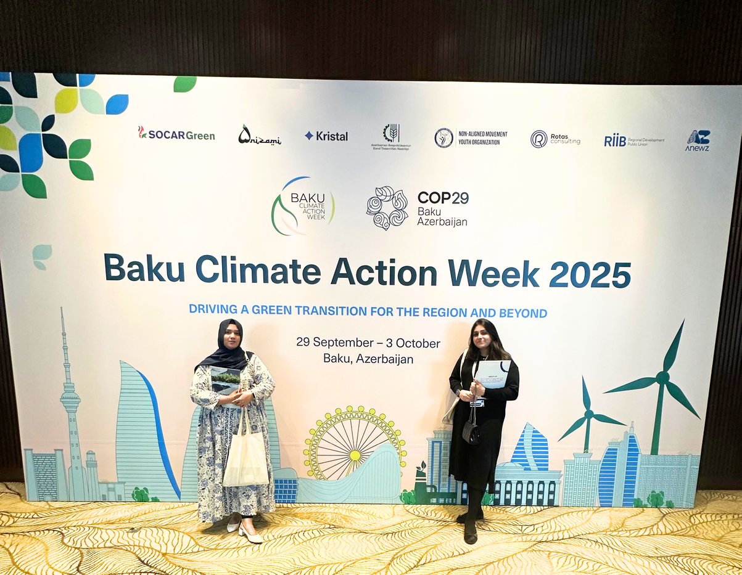



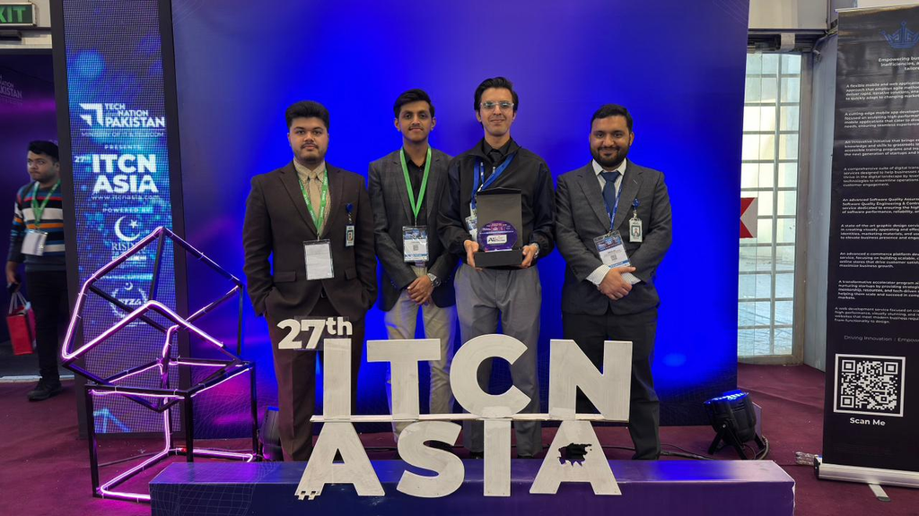
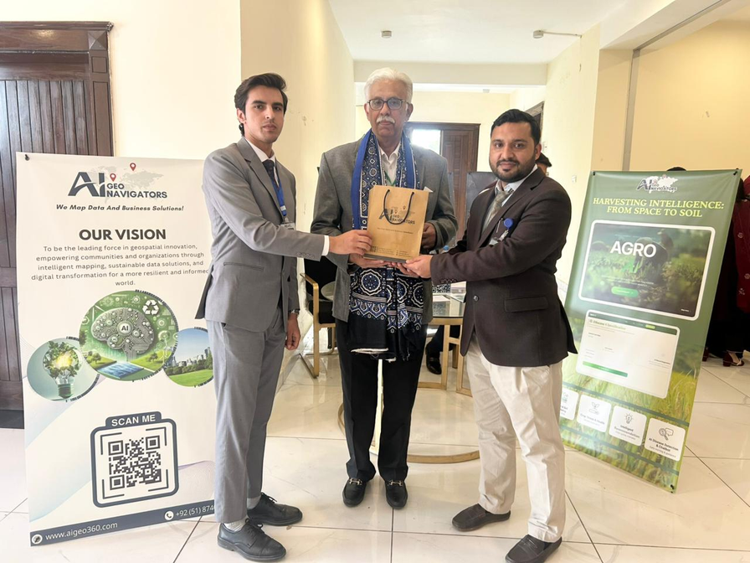
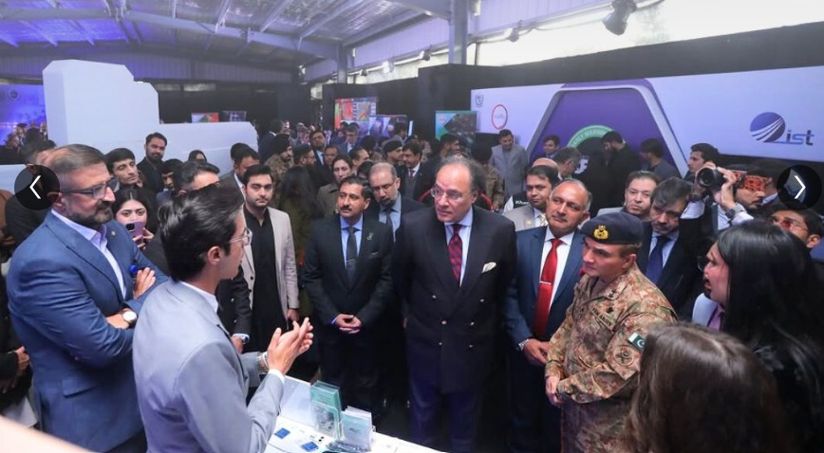
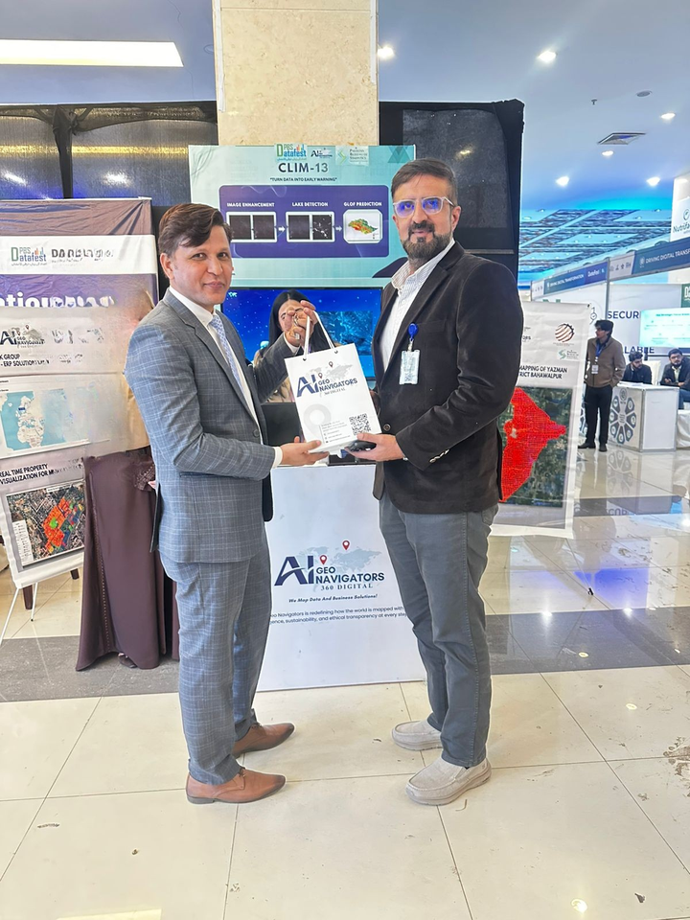

LOA WITH NDMA
WEBSUMMIT QATAR 2026
TORONTO CLIMATE WEEK
BAKU CLIMATE WEEK
NATIONAL & INTERNATIONAL PRESENCE
3RD INTERNATIONAL CONFERENCE ON PRECISION AND SUSTAINABLE AGRICULTURE UNDER CLIMATE CHANGE.
AT DATAFEST 2025
AT NDMA FOR DEWTE EXPO 2025
ITCN ASIA 2026, LAHORE

Slide 20
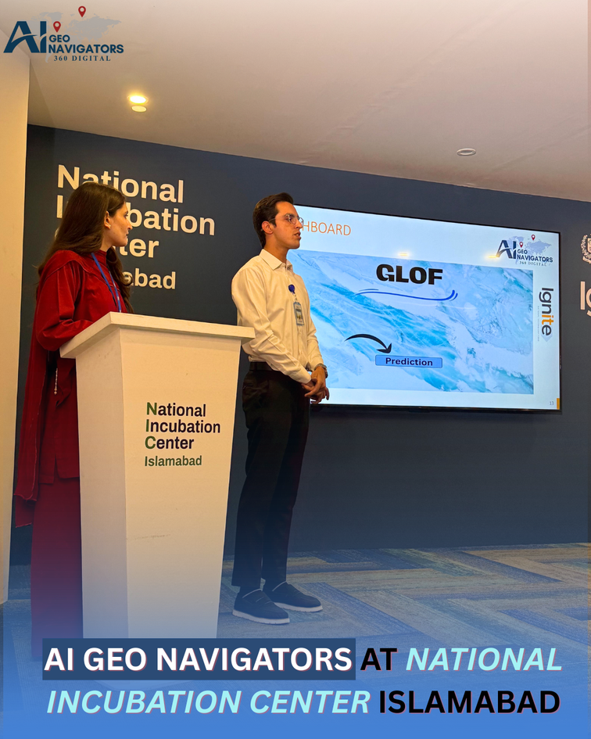
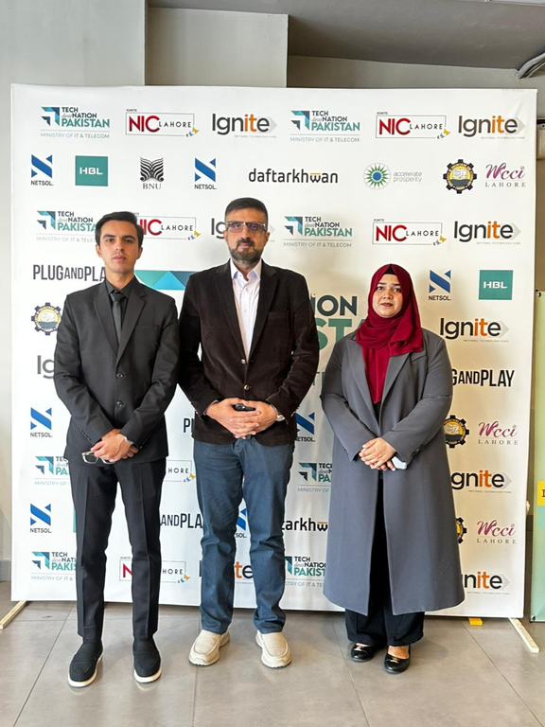
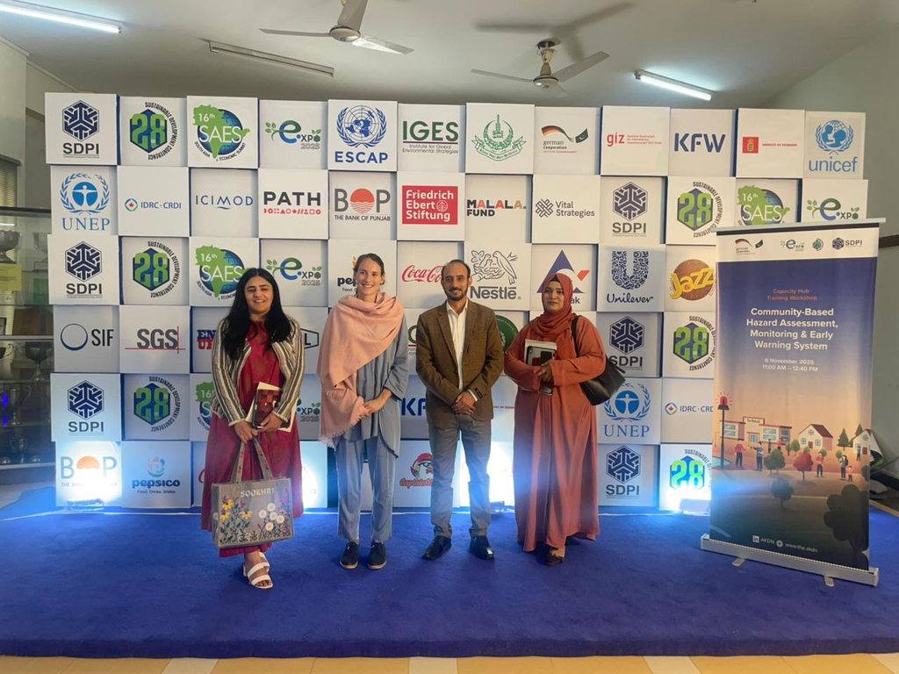
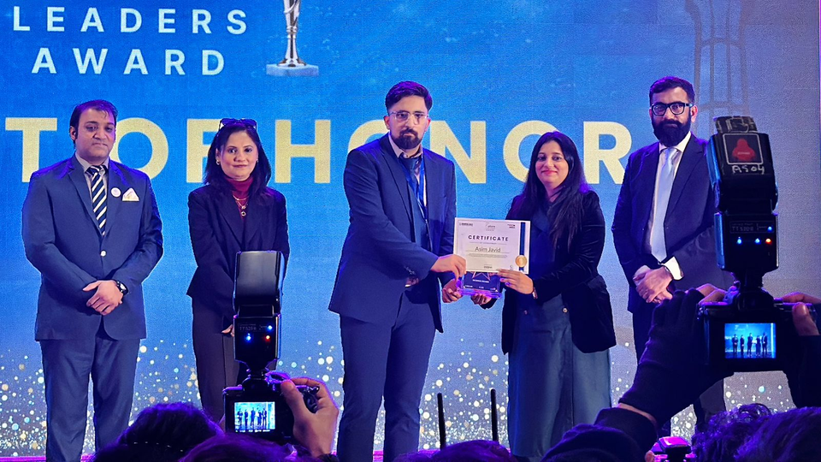
AWARDS/ACHIEVEMENTS
AI Wrapper Competition Islamabad , 9th position
NIC Cohort 3 selected
Disaster Resilience & Climate Risk Management
Future Leaders Award
𝐀𝐈 𝐆𝐞𝐨 𝐍𝐚𝐯𝐢𝐠𝐚𝐭𝐨𝐫𝐬 – 𝘊𝘰𝘮𝘮𝘶𝘯𝘪𝘵𝘺-𝘉𝘢𝘴𝘦𝘥 𝘍𝘰𝘳𝘦𝘤𝘢𝘴𝘵𝘪𝘯𝘨 𝘢𝘯𝘥 𝘌𝘢𝘳𝘭𝘺 𝘞𝘢𝘳𝘯𝘪𝘯𝘨 𝘰𝘧 𝘎𝘓𝘖𝘍𝘴 𝘪𝘯 𝘎𝘪𝘭𝘨𝘪𝘵-𝘉𝘢𝘭𝘵𝘪𝘴𝘵𝘢𝘯
(2026–2030)

Slide 21
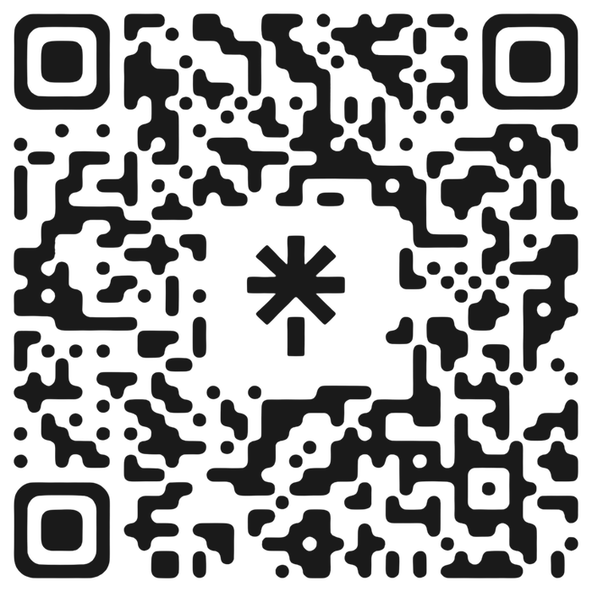
GET IN TOUCH

